Slide 1
陈鹏飞
数据科学与计算机学院
2018-06-22
chenpf7@mail.sysu.edu.cn

Slide 2
Lecture 17 — Distributed and Cloud Computing
--- Enabling Technologies
Pengfei Chen
School of Data and Computer Science
June 22, 2018
chenpf7@mail.sysu.edu.cn

Slide 3
Textbook

Slide 4
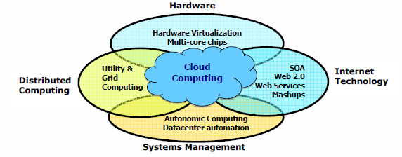
Data Deluge (数据洪流) Enabling New Challenges
The technologies underpinning Cloud computing
(Courtesy of Judy Qiu, Indiana University, 2011)

Slide 5
From Desktop/HPC/Grids to Internet Clouds in 30 Years
HPC moving from centralized supercomputers to geographically distributed desktops, desksides, clusters, and grids to clouds over last 30 years
R/D efforts on HPC, clusters, Grids, P2P, and virtual machines has laid the foundation of cloud computing that has been greatly advocated since 2007
Location of computing infrastructure in areas with lower costs in hardware, software, datasets, space, and power requirements – moving from desktop computing to datacenter-based clouds

Slide 6
Interactions among 4 technical challenges : Data Deluge（数据量）, Cloud Technology, eScience（电子商务）, and Multicore/Parallel Computing
(Courtesy of Judy Qiu, Indiana University, 2011)

Slide 7
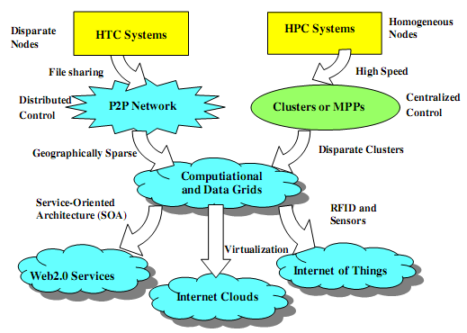
Clouds and Internet of Things
HPC: High-Performance Computing
HTC: High-Throughput Computing
P2P: Peer to Peer
MPP: Massively Parallel Processors
Source: K. Hwang, G. Fox, and J. Dongarra, Distributed and Cloud Computing, Morgan Kaufmann, 2012.
Notes:
云计算发展路径：
HTC（吞吐量）
HPC（性能）
计算、数据网格

Slide 8
Computing Paradigm Distinctions
Centralized Computing
All computer resources are centralized in one physical system.
Parallel Computing
All processors are either tightly coupled with central shard memory or loosely coupled with distributed memory
Distributed Computing
Field of CS/CE that studies distributed systems. A distributed system consists of multiple autonomous computers, each with its own private memory, communicating over a network.
Cloud Computing
An Internet cloud of resources that may be either centralized or decentralized. The cloud applies to parallel or distributed computing or both. Clouds may be built from physical or virtualized resources.
Notes:
集中计算
并行计算
分布式计算
云计算（虚拟化、屏蔽底层）

Slide 9
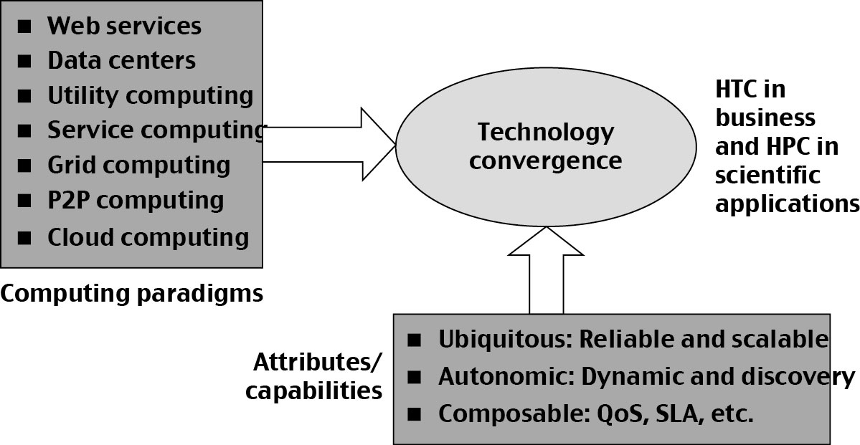
Technology Convergence toward HPC for Science and HTC for Business: Utility Computing
(Courtesy of Raj Buyya, University of Melbourne, 2011)

Slide 10
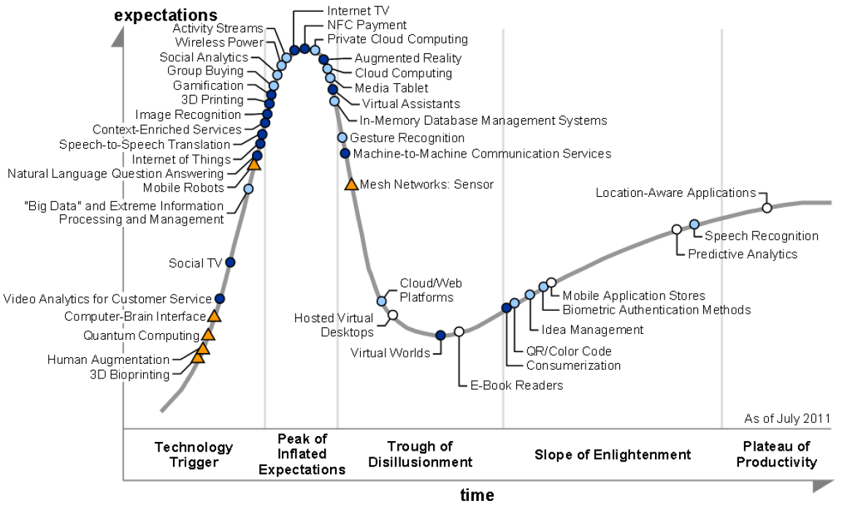
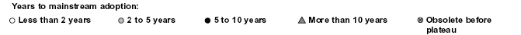
2011 Gartner “IT Hype Cycle” for Emerging Technologies
2008
2007

Slide 11
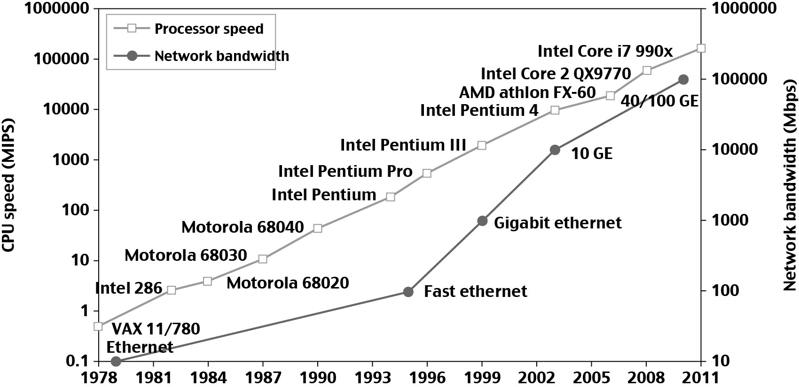
Technologies for Network-based Systems
33 year Improvement in Processor and Network Technologies

Slide 12
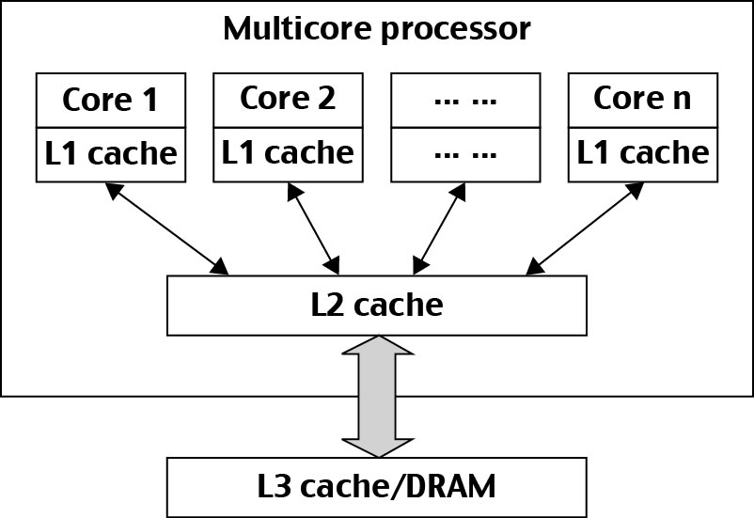
Modern Multi-core CPU Chip

Slide 13
Multi-threading Processors
Four-issue (e.g. Sun Ultrasparc I)
Implements instruction level parallelism (ILP) within a single processor.
Executes more than one instruction during a clock cycle by sending multiple instructions to redundant functional units.
Fine-grain multithreaded processor
Switch threads after each cycle
Interleave instruction execution
If one thread stalls, others are executed
Coarse-grain multithreaded processor
Executes a single thread until it reaches certain situations
Simultaneous multithread processor (SMT)
Instructions from more than one thread can execute in any given pipeline stage at a time.

Slide 14
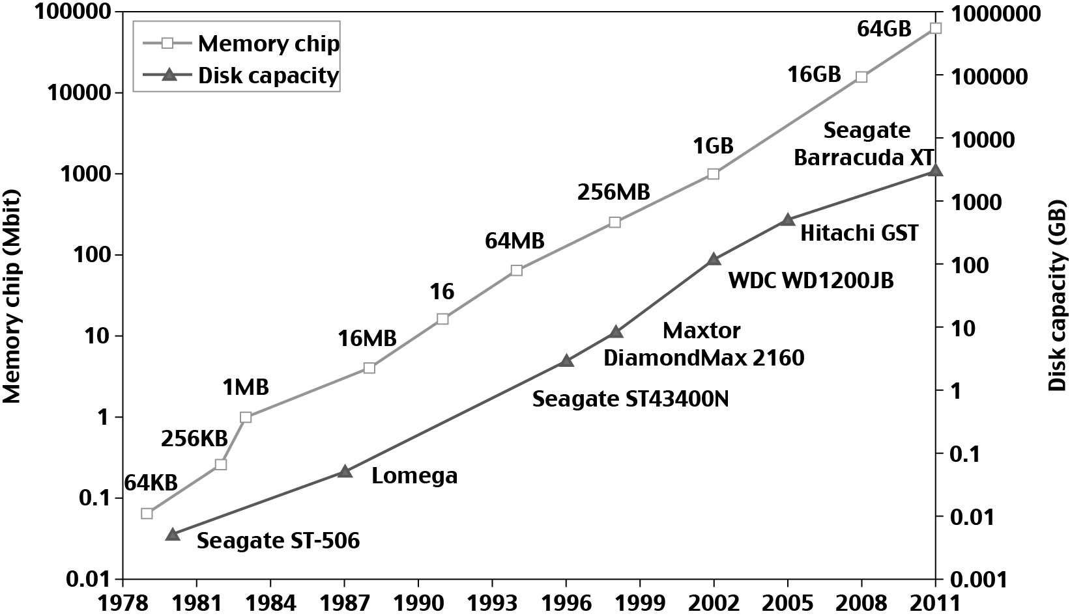
33 year Improvement in Memory and Disk Technologies

Slide 15
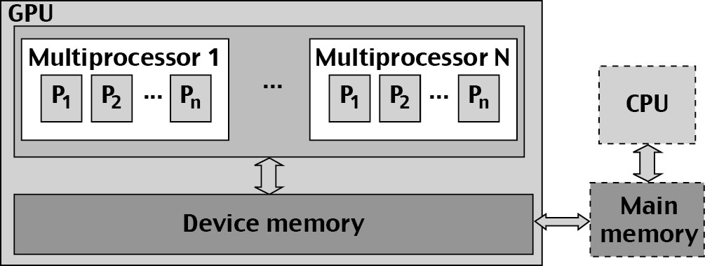
Architecture of A Many-Core Multiprocessor GPU interacting with a CPU Processor

Slide 16
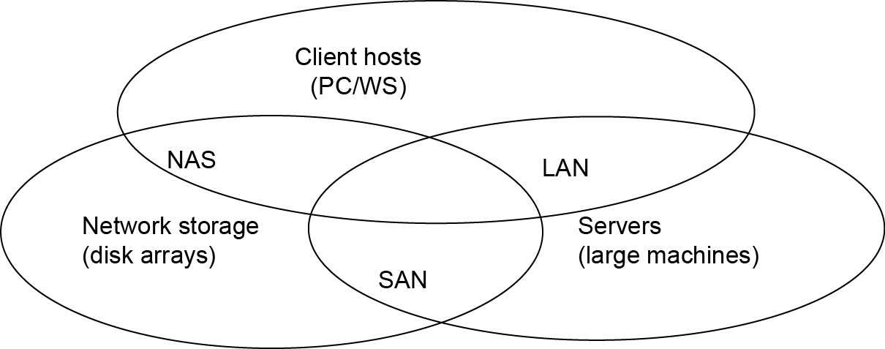
Interconnection Networks
SAN (storage area network) - connects servers with disk arrays
LAN (local area network) – connects clients, hosts, and servers
NAS (network attached storage) – connects clients with large storage systems
Notes:
San:存储网络
Lan：
Nas：

Slide 17
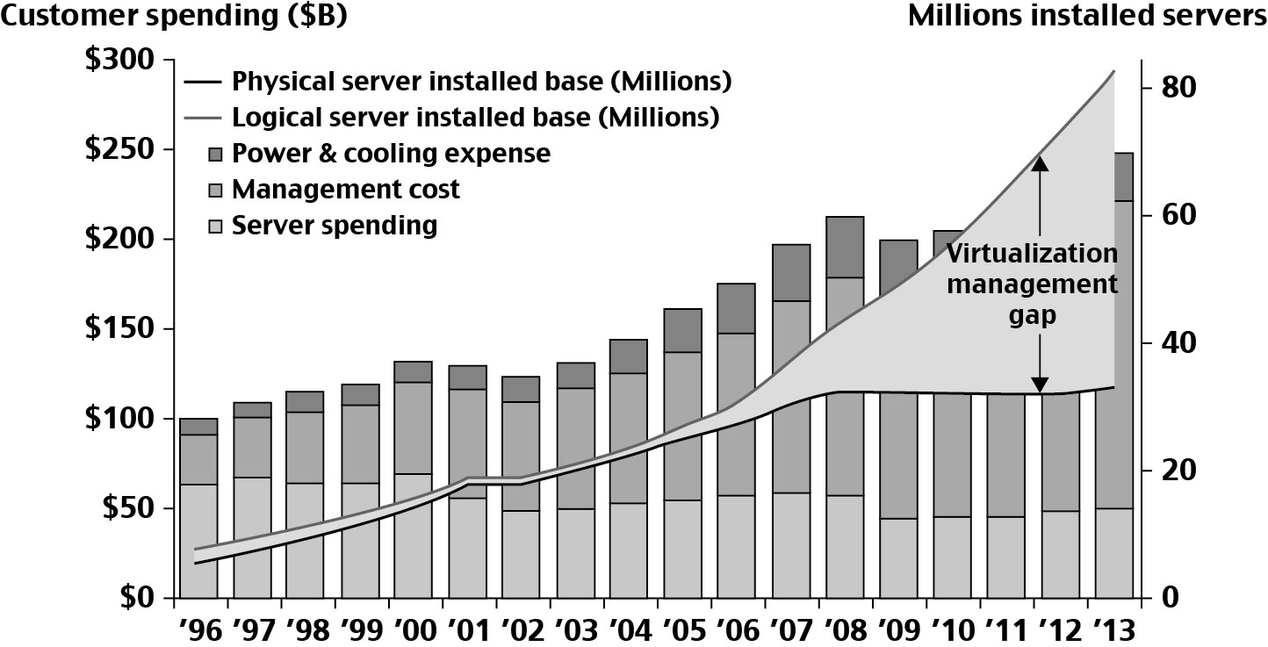
Datacenter and Server Cost Distribution
Notes:
管理代价逐年加大
虚拟机数量逐年增大，物理机数量停滞

Slide 18
Virtual Machines
Eliminate real machine constraint
Increases portability and flexibility
Virtual machine adds software to a physical machine to give it the appearance of a different platform or multiple platforms.
Benefits
Cross platform compatibility
Increase Security
Enhance Performance
Simplify software migration

Slide 19
Initial Hardware Model
All applications access hardware resources (i.e. memory, i/o) through system calls to operating system (privileged instructions)
Advantages
Design is decoupled (i.e. OS people can develop OS separate of Hardware people developing hardware)
Hardware and software can be upgraded without notifying the Application programs
Disadvantage
Application compiled on one ISA （工业标准架构）will not run on another ISA..
Applications compiled for Mac use different operating system calls then application designed for windows.
ISA’s must support old software
Can often be inhibiting in terms of performance
Since software is developed separately from hardware… Software is not necessarily optimized for hardware.

Slide 20
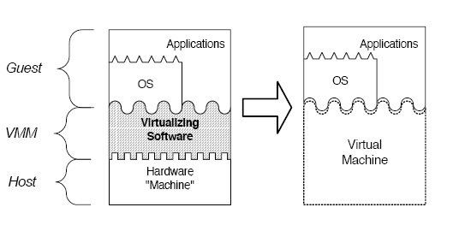
Virtual Machine Basics
Virtual software placed between underlying machine and conventional software
Conventional software sees different ISA from the one supported by the hardware
Virtualization process involves:
Mapping of virtual resources (registers and memory) to real hardware resources
Using real machine instructions to carry out the actions specified by the virtual machine instructions

Slide 21
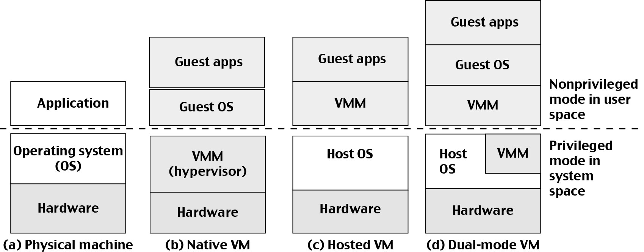
Three VM Architectures

Slide 22
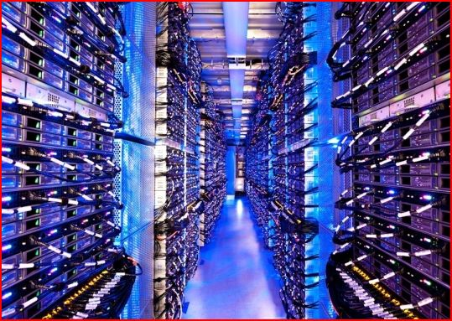

Above the Clouds: A Berkeley View of Cloud Computing
The Cloud
Historical roots in today’s Internet apps
Search, email, social networks
File storage (Live Mesh, Mobile Me, Flicker, …)
A cloud infrastructure provides a framework to manage scalable, reliable, on-demand access to applications
A cloud is the “invisible” backend to many of our mobile applications
A model of computation and data storage based on “pay as you go” access to “unlimited” remote data center capabilities

Slide 23
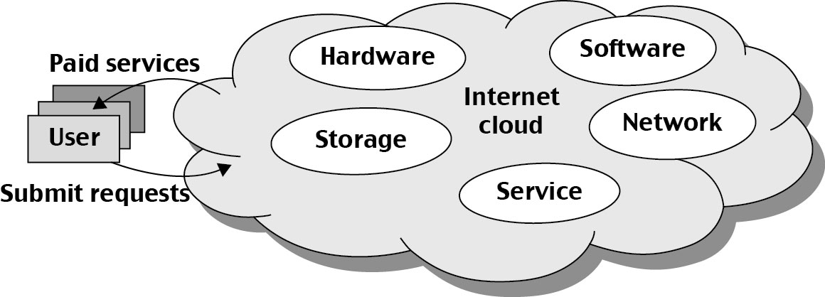
Basic Concept of Internet Clouds
Cloud computing is the use of computing resources (hardware and software) that are delivered as a service over a network (typically the Internet).
The name comes from the use of a cloud-shaped symbol as an abstraction for the complex infrastructure it contains in system diagrams.
Cloud computing entrusts remote services with a user's data, software and computation.

Slide 24
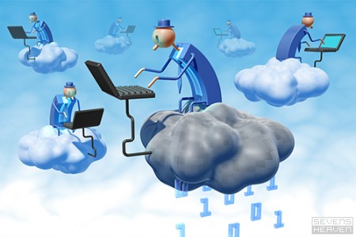
The Next Revolution in IT Cloud Computing
Classical Computing
Buy & Own
Hardware, System Software, Applications often to meet peak needs.
Install, Configure, Test, Verify, Evaluate
Manage
..
Finally, use it
$$$$....$(High CapEx)
Cloud Computing
Subscribe
Use
$ - pay for what you use, based on QoS
Every 18 months?
(Courtesy of Raj Buyya, 2012)

Slide 25
Cloud Service Models (1)
Infrastructure as a service (IaaS)
Most basic cloud service model
Cloud providers offer computers, as physical or more often as virtual machines, and other resources.
Virtual machines are run as guests by a hypervisor, such as Xen or KVM.
Cloud users deploy their applications by then installing operating system images on the machines as well as their application software.
Cloud providers typically bill IaaS services on a utility computing basis, that is, cost will reflect the amount of resources allocated and consumed.
Examples of IaaS include: Amazon CloudFormation (and underlying services such as Amazon EC2), Rackspace Cloud, Terremark, and Google Compute Engine.

Slide 26
Cloud Service Models (2)
Platform as a service (PaaS)
Cloud providers deliver a computing platform typically including operating system, programming language execution environment, database, and web server.
Application developers develop and run their software on a cloud platform without the cost and complexity of buying and managing the underlying hardware and software layers.
Examples of PaaS include: Amazon Elastic Beanstalk, Cloud Foundry, Heroku, Force.com, EngineYard, Mendix, Google App Engine, Microsoft Azure and OrangeScape.

Slide 27
Cloud Service Models (3)
Software as a service (SaaS)
Cloud providers install and operate application software in the cloud and cloud users access the software from cloud clients.
The pricing model for SaaS applications is typically a monthly or yearly flat fee per user, so price is scalable and adjustable if users are added or removed at any point.
Examples of SaaS include: Google Apps, innkeypos, Quickbooks Online, Limelight Video Platform, Salesforce.com, and Microsoft Office 365.

Slide 28
Cloud Computing Challenges: Dealing with too many issues (Courtesy of R. Buyya)
Pricing
Scalability
Virtualization
Resource Metering
Reliability
QoS
Billing
Service Level
Agreements
Energy Efficiency
Provisioning
on Demand
Utility & Risk Management
Security
Legal & Regulatory
Privacy
Software Eng. Complexity
Trust
Programming Env. & Application Dev.

Slide 29
Dimensions of Scalability（考试内容）
Size – increasing performance by increasing machine size
Software – upgrade to OS, libraries, new apps.
Application – matching problem size with machine size
Technology – adapting system to new technologies

Slide 30
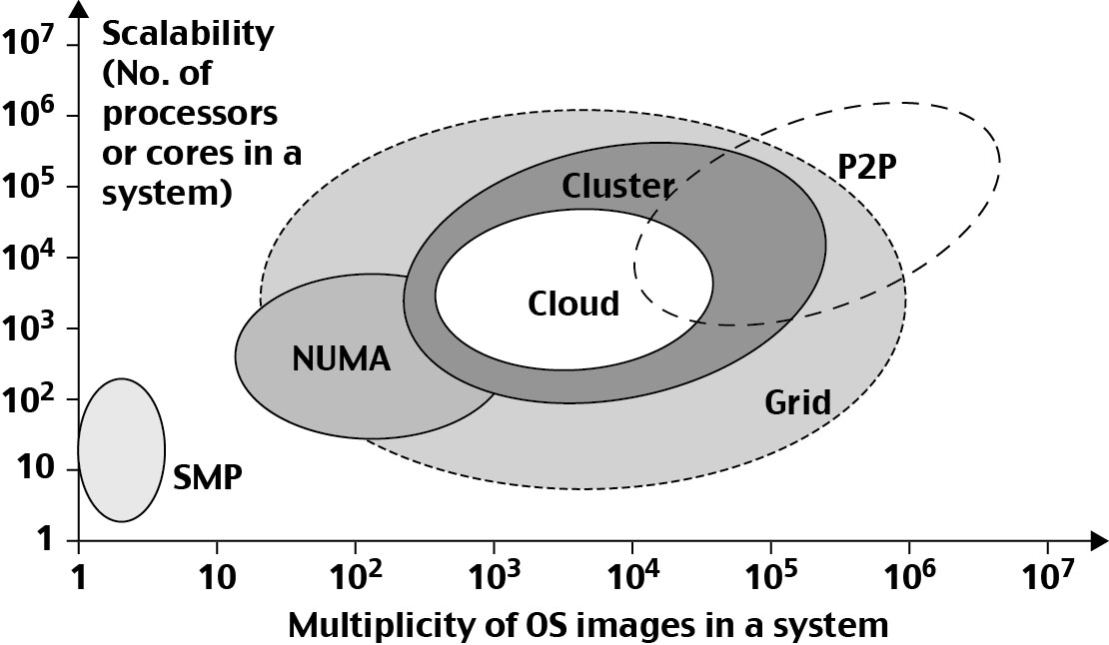
System Scalability vs. OS Multiplicity (多重性)

Slide 31
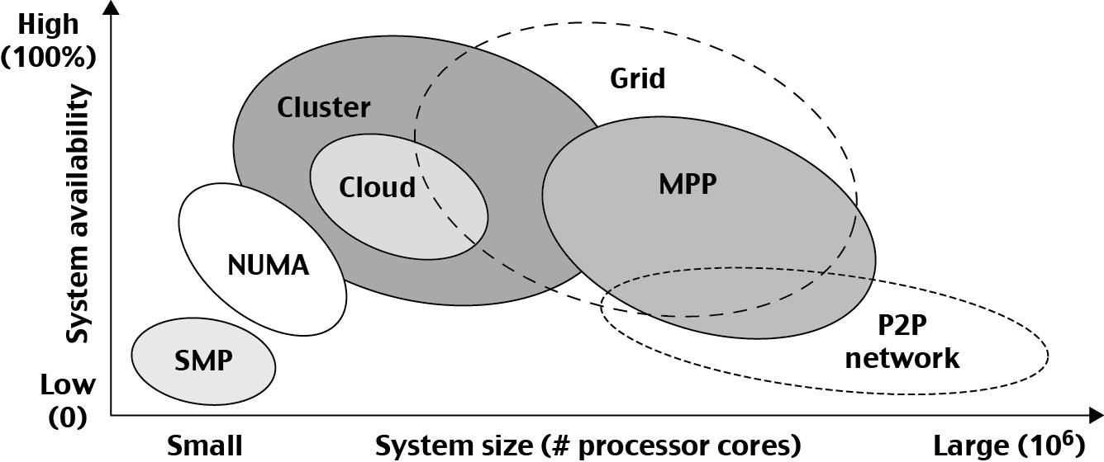
System Availability（可用性） vs. Configuration Size （配置数量）:

Slide 32
Operational Layers of Distributed Computing System

Slide 33
A typical cloud
应用层
天气预测
智能交通
医疗健康
消费习惯分析
地理环境
生物信息
视频推荐
+ 更多...
AI框架层
Tensorflow
SparkML
Theano
H2O
R 统计
自定义AI服务
Deeplearning4j
Caffe
Torch
SystemML
sklearn
+ 更多...
数据层
数据爬虫
数据存储
数据转换
数据装载
数据分析
云平台
部署
调度
自动扩展
+ 更多...
云运维
（AIOperator）
Kubernetes
云管理平台
基础设施
存储
计算
网络
+ 更多...

Slide 34
Four Reference Books:
K. Hwang, G. Fox, and J. Dongarra, Distributed and Cloud Computing: from Parallel Processing to the Internet of Things Morgan Kauffmann Publishers, 2011
R. Buyya, J. Broberg, and A. Goscinski (eds), Cloud Computing: Principles and Paradigms, ISBN-13: 978-0470887998, Wiley Press, USA, February 2011.
T. Chou, Introduction to Cloud Computing: Business and Technology, Lecture Notes at Stanford University and at Tsinghua University, Active Book Press, 2010.
T. Hey, Tansley and Tolle (Editors), The Fourth Paradigm : Data-Intensive Scientific Discovery, Microsoft Research, 2009.

Slide 35
Thank You !

